Slide 1
IBM Data Science Capstone

Slide 2
Outline
Use case
Dataset
Data Exploration (EDA)
Data Cleansing – Data Aggregation
Model Definition and Training
Model Evaluation

Slide 3
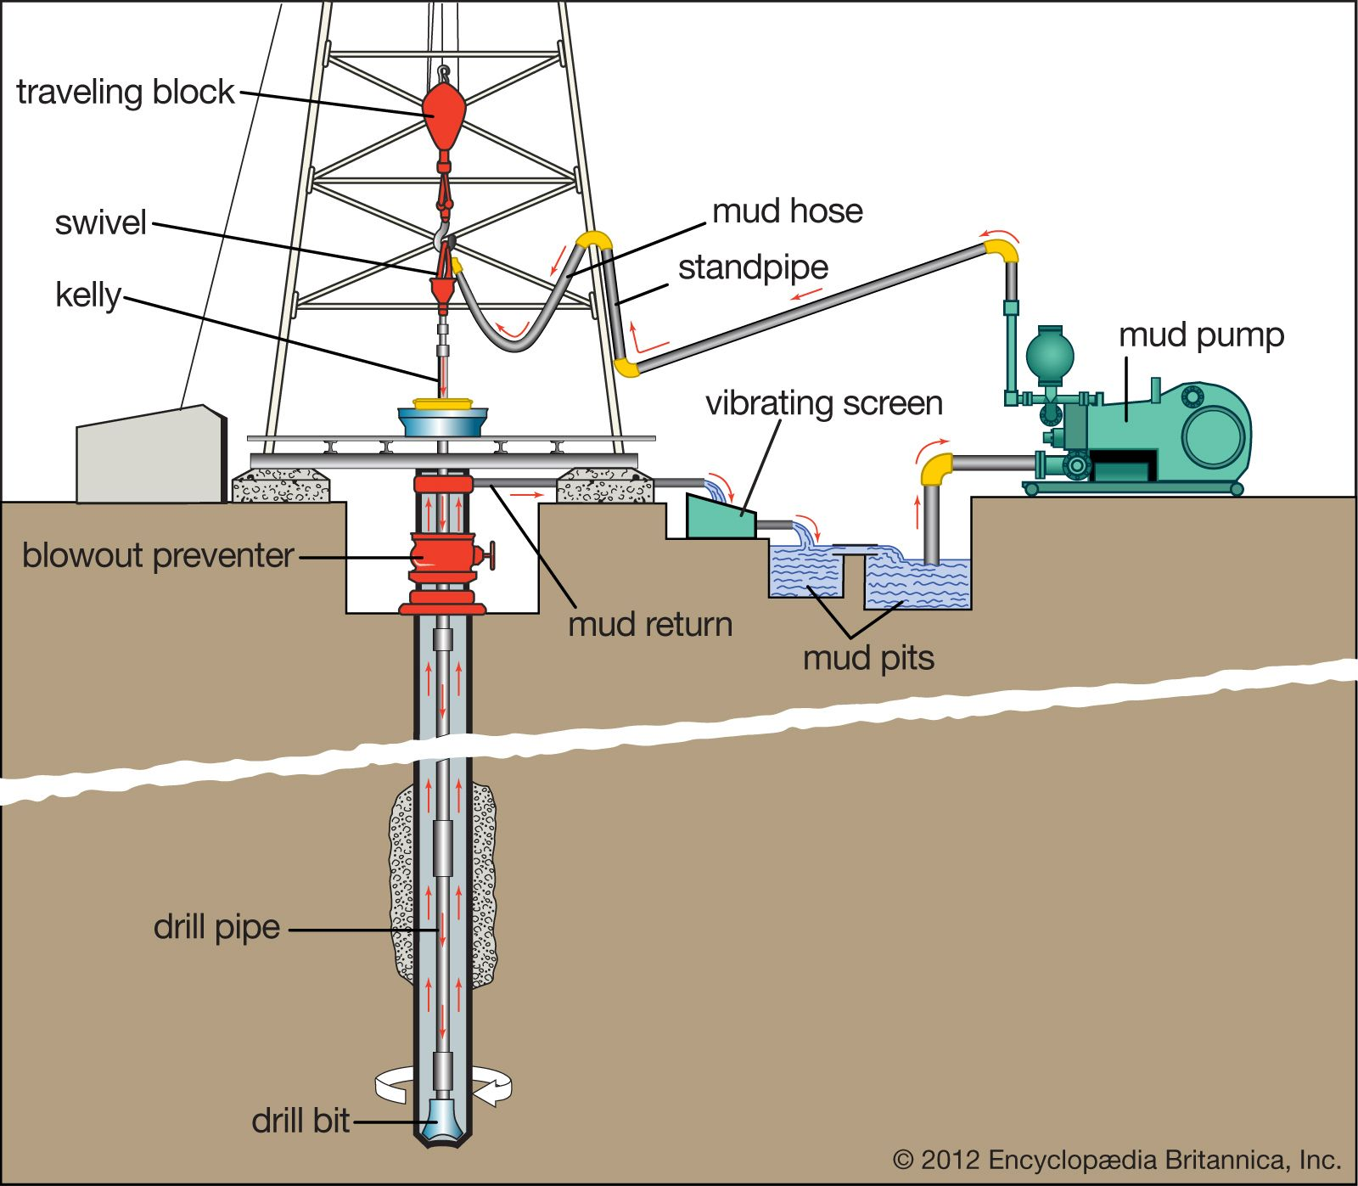
Use Case
Classify drilling activity based on drilling rig sensor data
Measure time spent for each activity, providing a measure of operational efficiency
Identify best practices and parameters for certain drilling activities

Slide 4
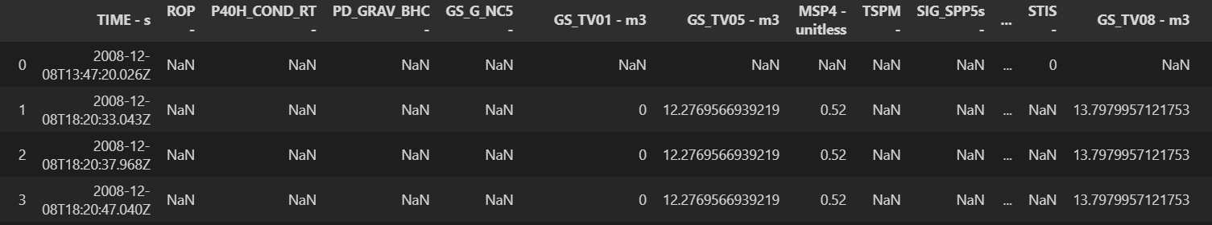
Dataset
Dataset was obtained from Equinor’s Volve
(https://www.equinor.com/en/what-we-do/digitalisation-in-our-dna/volve-field-data-village-download.html)
Lots of different data available from Geophysical interpretations, production data, written reports, reservoir models, well logs and etc.
Of focus in this project would be drilling time logs in the WITSML format.
Used two short excerpts from two separate wells
Well F5 – 17.5” hole section
Well F15 – 17.5” hole section
Utilize beautifulsoup to convert to Dataframe format
Well | Dataframe snip size
F5 – 17.5” | 183774 rows × 102 columns
F15 – 17.5” | 360881 rows × 130 columns

Slide 5
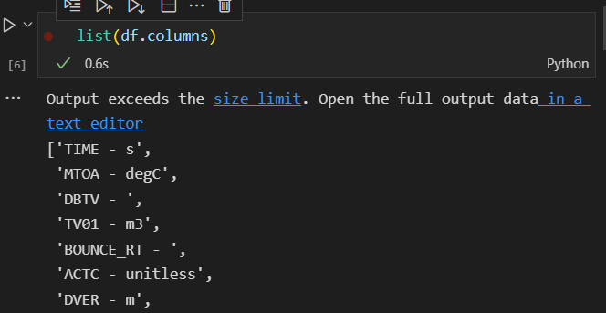
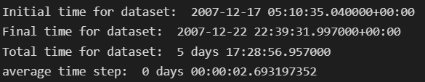
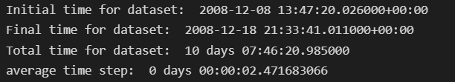
Data Exploration
Rows – data points at specific time stamp
Columns – Sensor type with specific mnemonic
Initial Dataframe sizes
Dataframe time range and average timestep
Well - F5
Well - F15
Well | Dataframe snip size
F5 – 17.5” | 183774 rows × 102 columns
F15 – 17.5” | 360881 rows × 130 columns

Slide 6
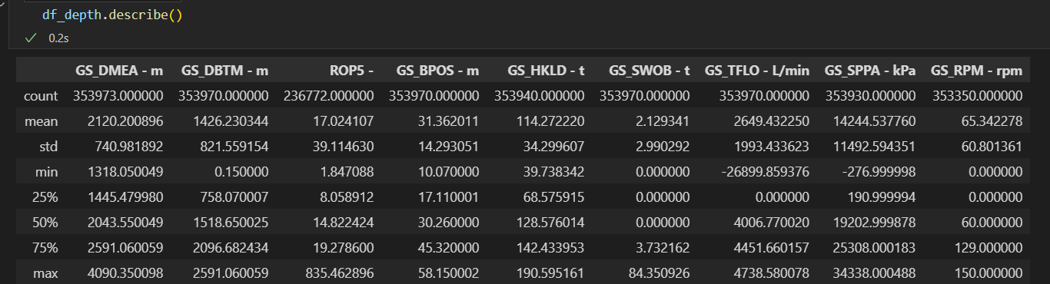
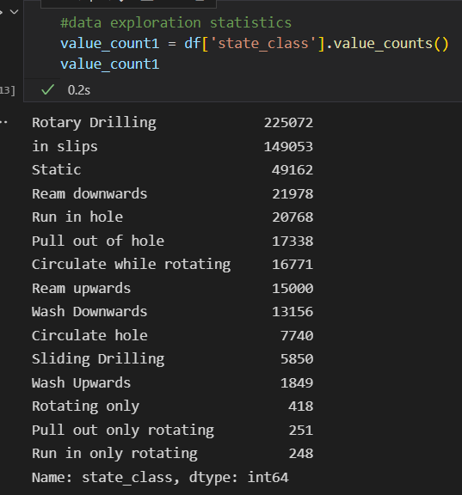
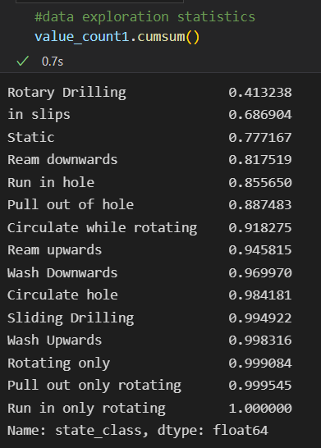
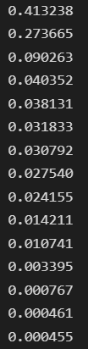
Data Exploration
Combine datasets into one
Data quality issues – some sensors readings out of limit
In this case set all negative TFLO readings to 0
Initial Dataset do not have labels!
Labels created using feature engineering + conditional filters
Data Exploration - Population distribution of classes
Over 77% of time spend either drilling, in slips or static.
Some activities are poorly represented

Slide 7
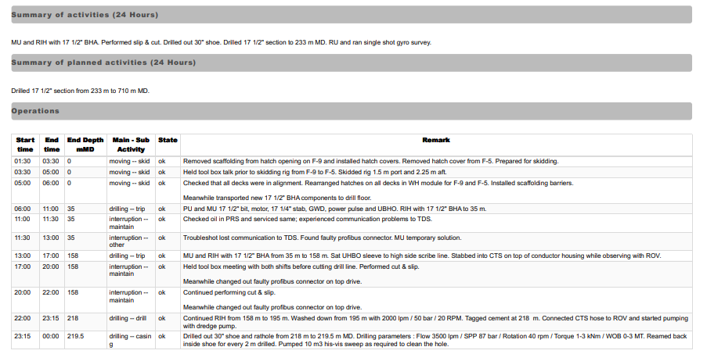
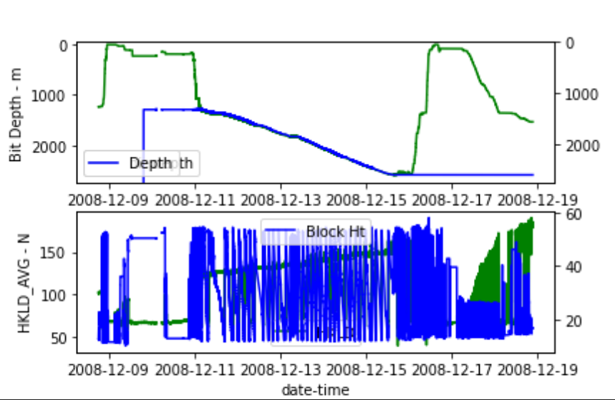
Data Exploration
Drilling Activity – Crosscheck with Daily Drilling Report (DDR)
Drilling phase – 17.5” Hole Section
Data Visualization-
Check timelog graph Bit depth vs hole depth increasing trend shows drilling phase

Slide 8
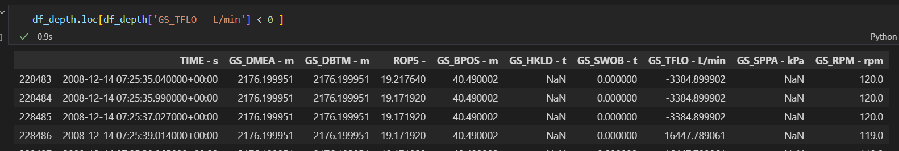
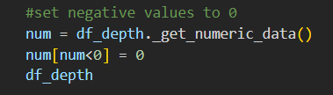
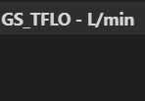
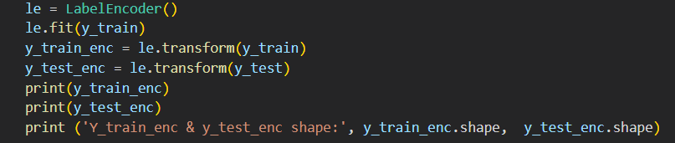

Data Cleansing / Feature Engineering
Convert WITSML data format to Dataframe and save to CSV files
Data Cleaning : Ensure all dtypes consistent and any blank data cells filled in between
Set all –’ve values to 0 as all data types chosen should not have negative values
Feature Engineering + Scaling
Multi-class problem : Data normalization, label encoding for outputs

Slide 9
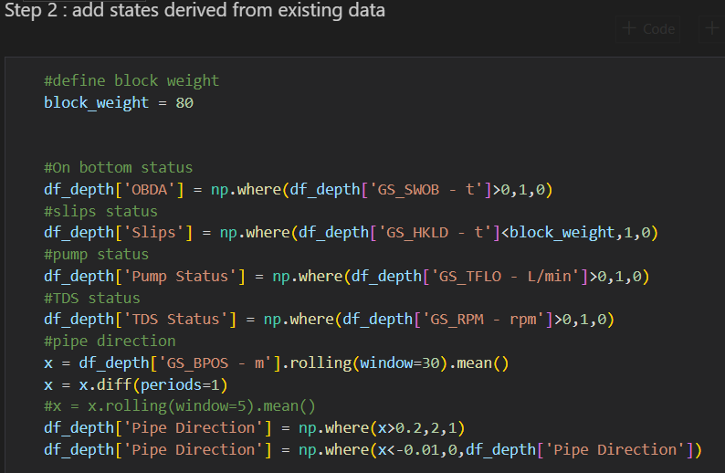
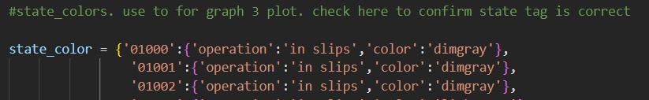
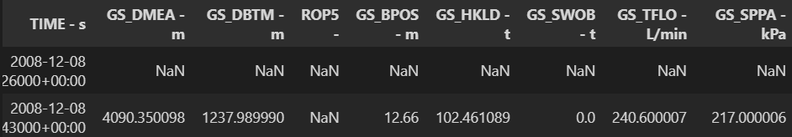
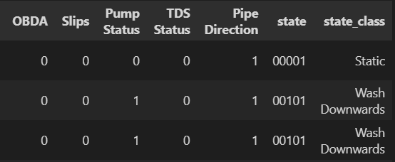
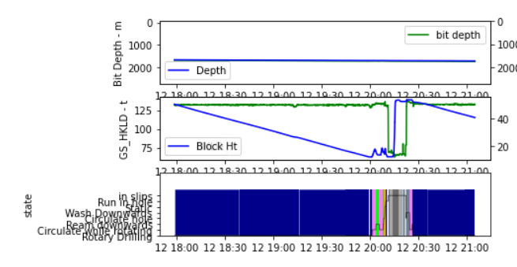
Model Creation
Initial Dataset only sensor data
Dataset tagged with labels by using a conditional format
Compare graphs versus mapped states

Slide 10
Model Training
Attempt to use 5 ML techniques
K Nearest Neighbors
Decision Tree
Support Vector Machine – not done for this dataset – too large
Logistic Regression
LSTM Neural Network
Combined both F5 and F15 datasets into one large dataset. Split into train and test (80:20 split)

Slide 11
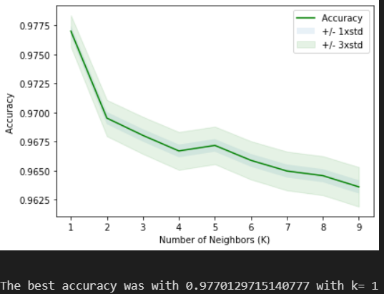
K Nearest Neighbors
Measured accuracy by comparing predicted values vs test values.
Trained using KNN using Sklearn plugin.
Loop training program in order to find optimum K
Optimum K is 1

Slide 12
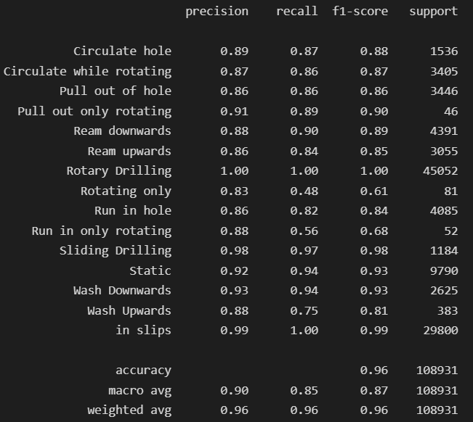
K Nearest Neighbors
Utilize classification report to give better insight into model performance
Precision , Recall, F1 Score
Support / count number
Confusion matrix to better identify false positives / negatives

Slide 13
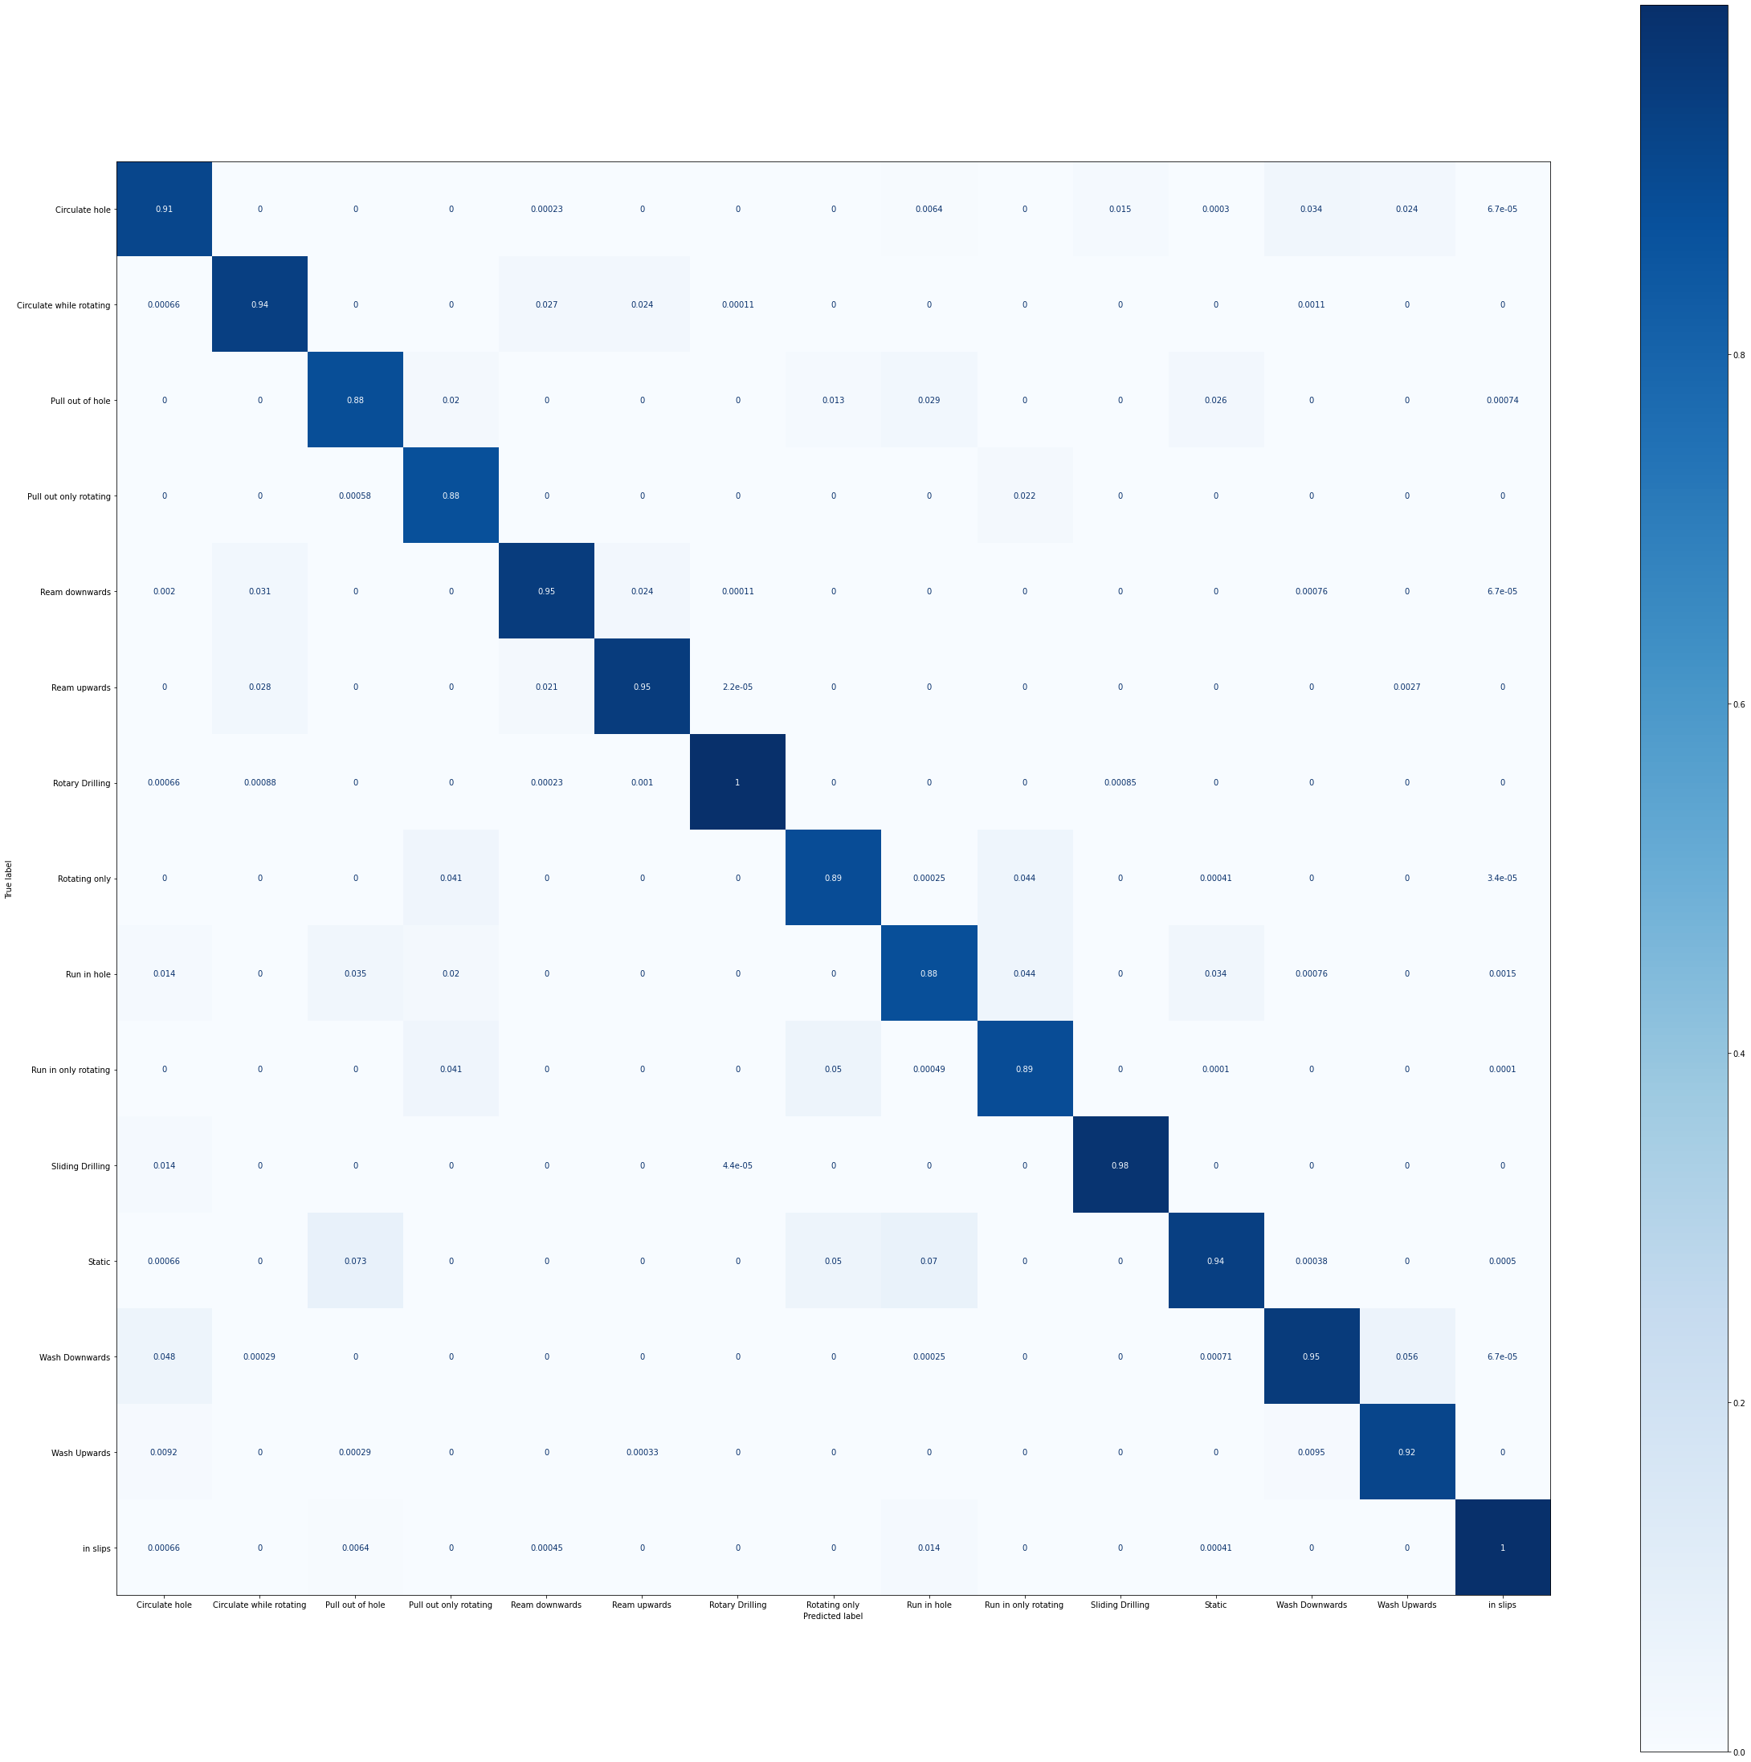
K Nearest Neighbors
Utilize classification report to give better insight into model performance
Precision , Recall, F1 Score
Support / count number
Confusion matrix to better identify false positives / negatives

Slide 14
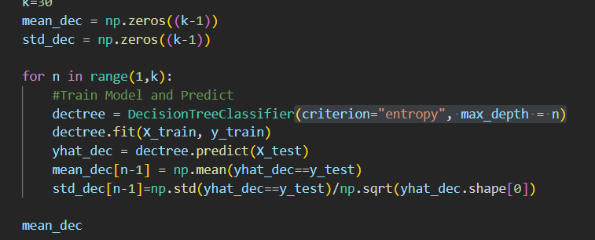
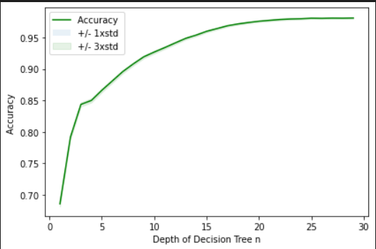
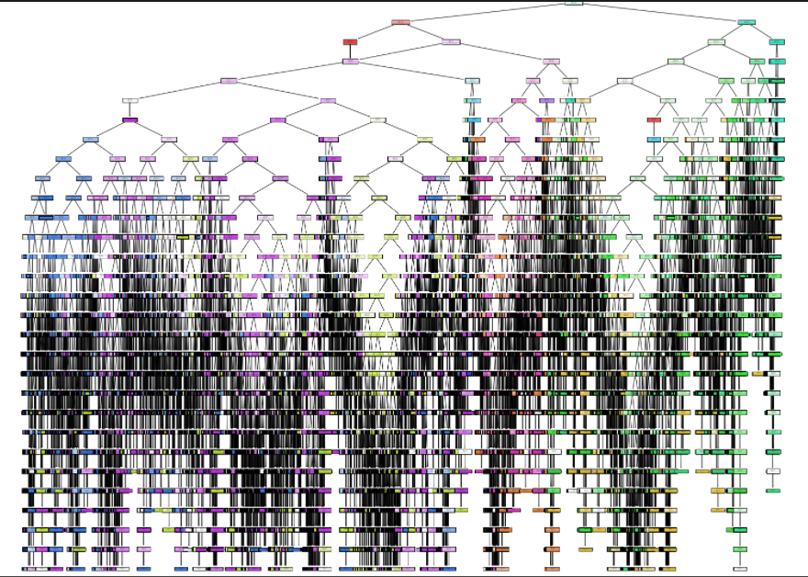
Decision Tree
Trained using entropy criterion
Looped training with depth from 1:30
Best accuracy obtained at k=29
Depth and width of Decision Tree makes it difficult to give understanding to model

Slide 15
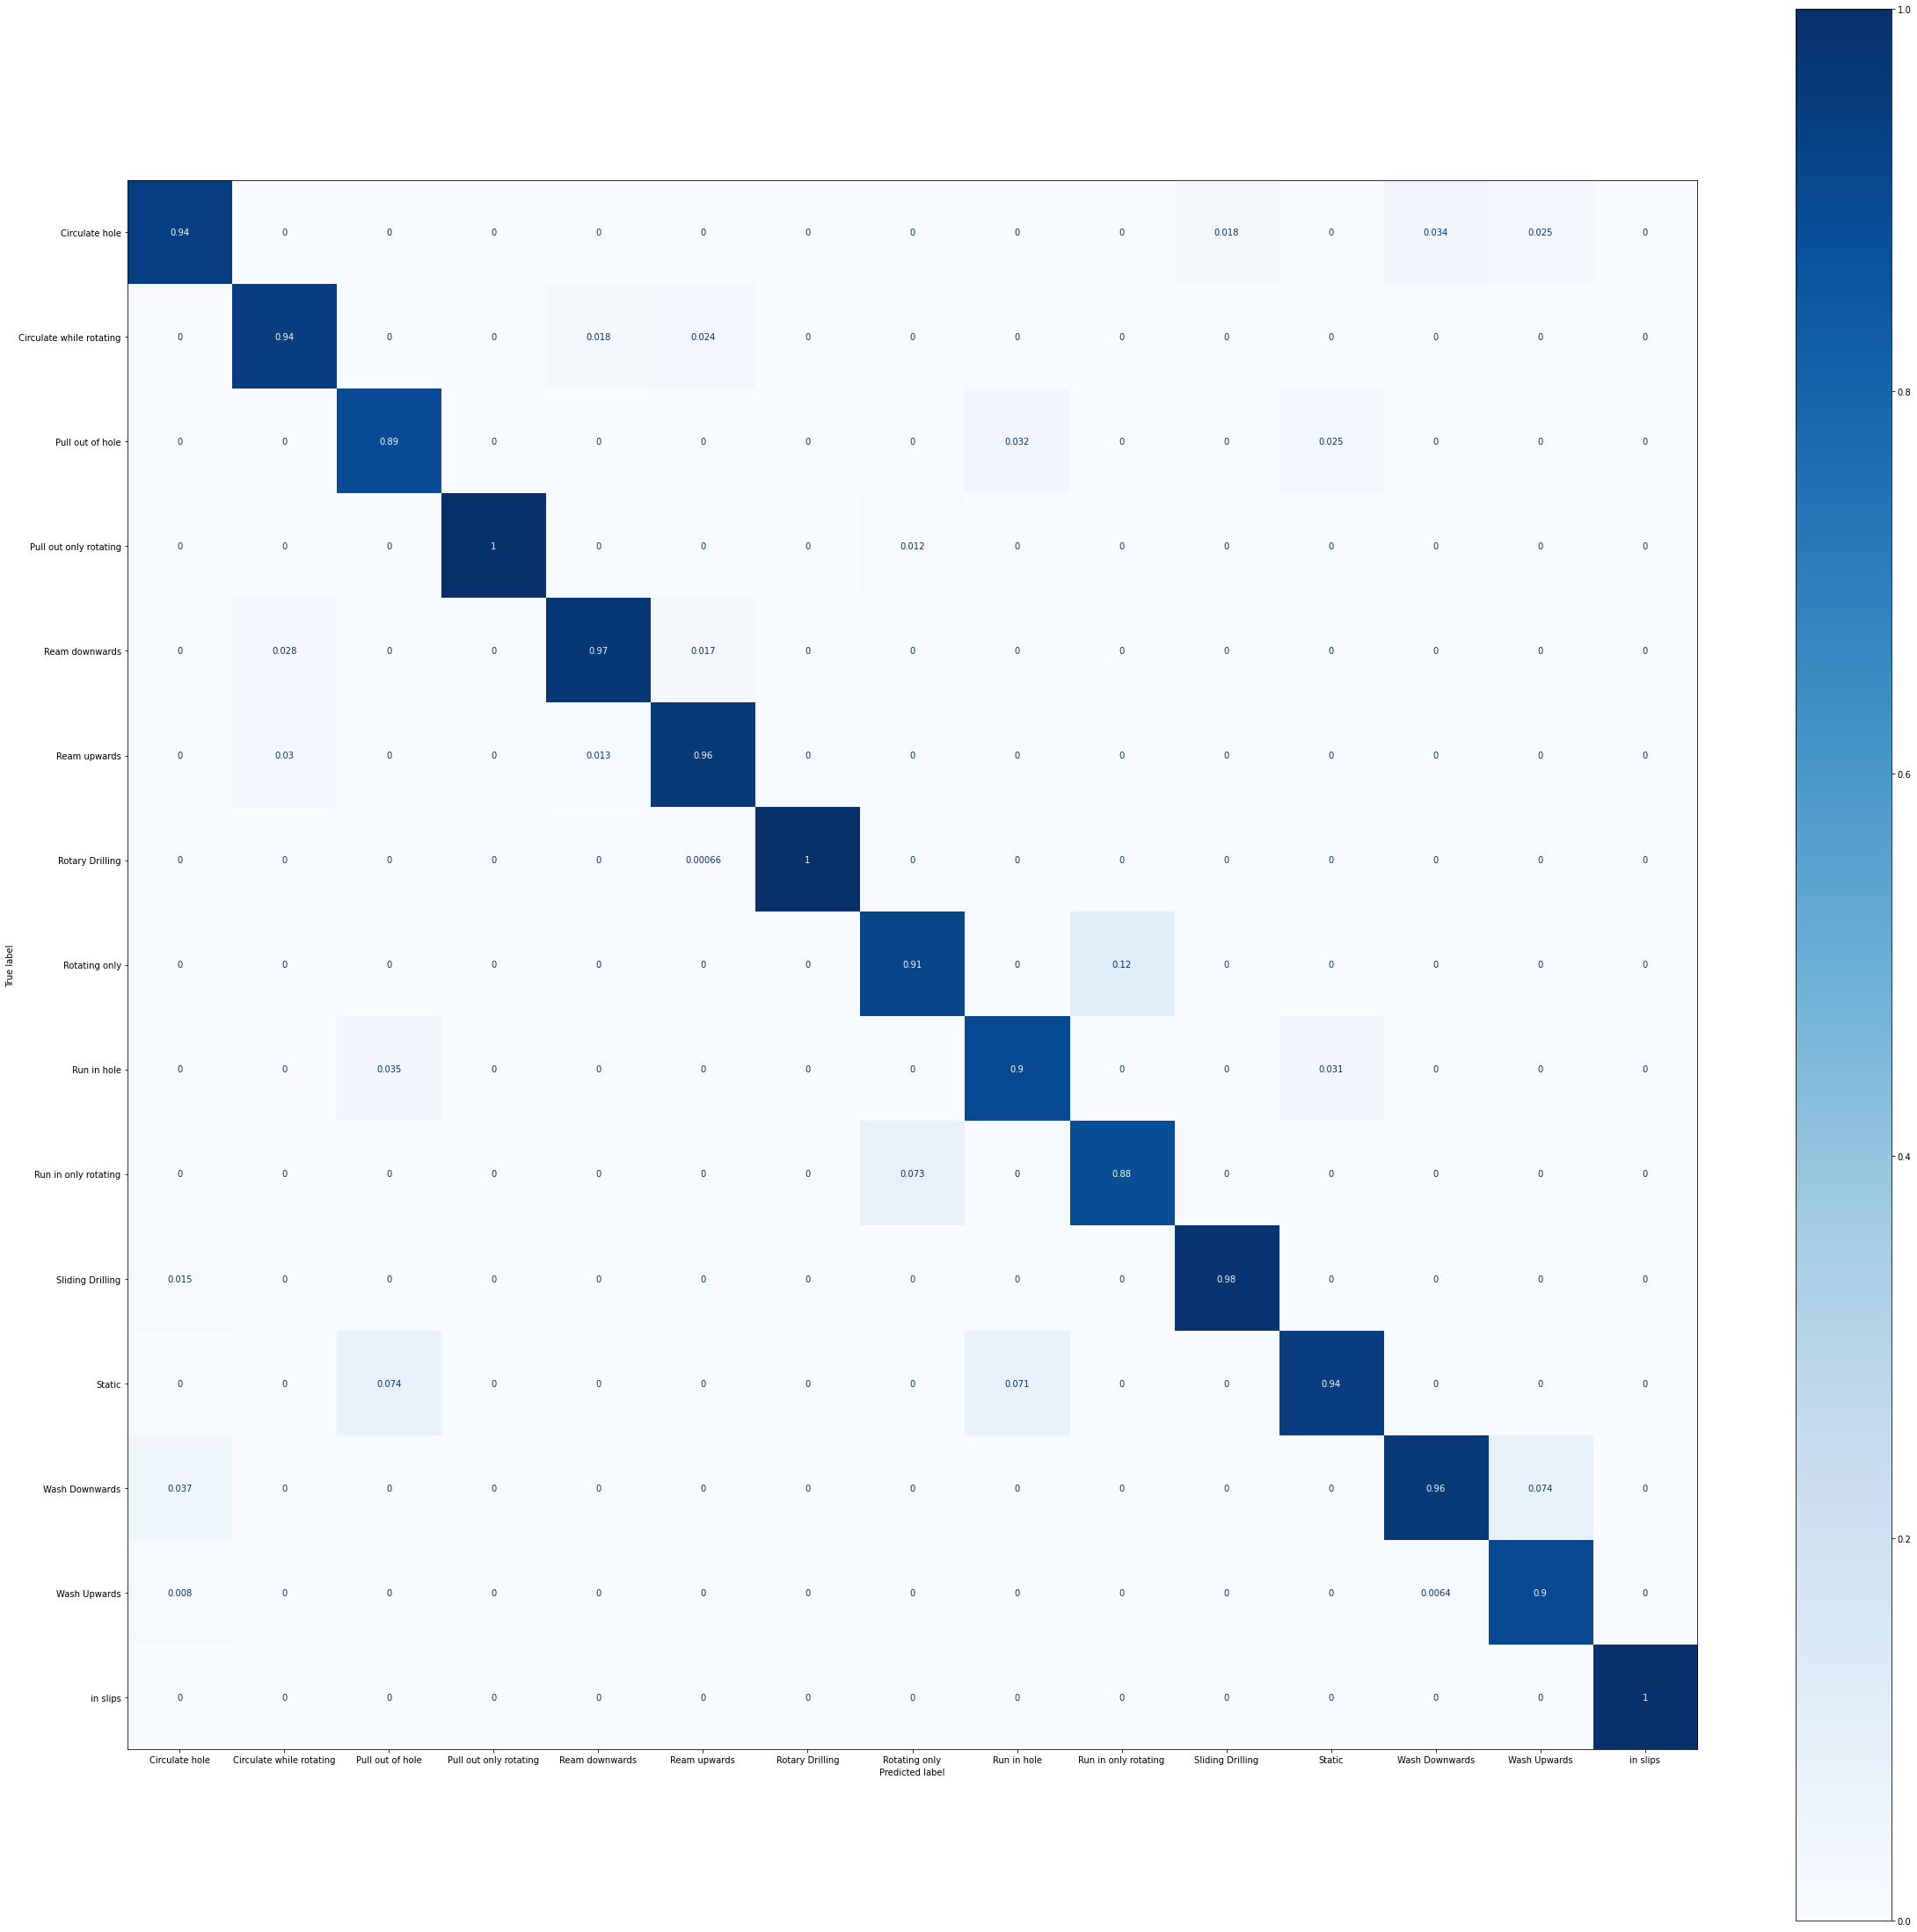
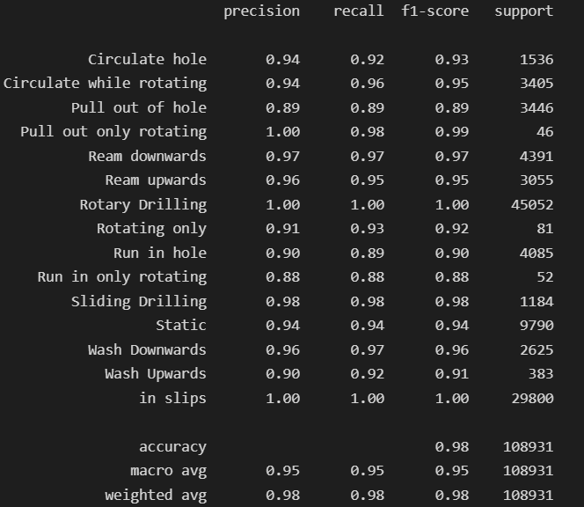
Decision Tree
Same as prior model

Slide 16
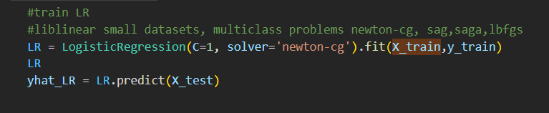
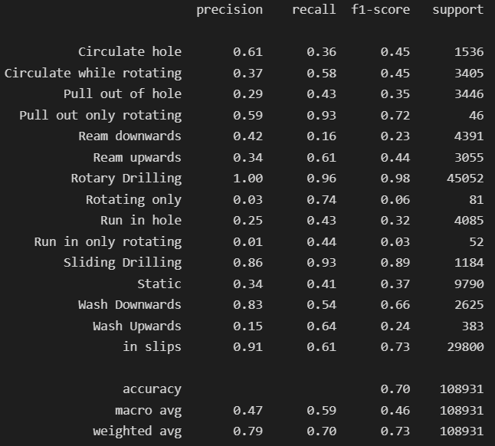
Logistic Regression
Trained using newton-cg solver with no regularization (C=1)

Slide 17
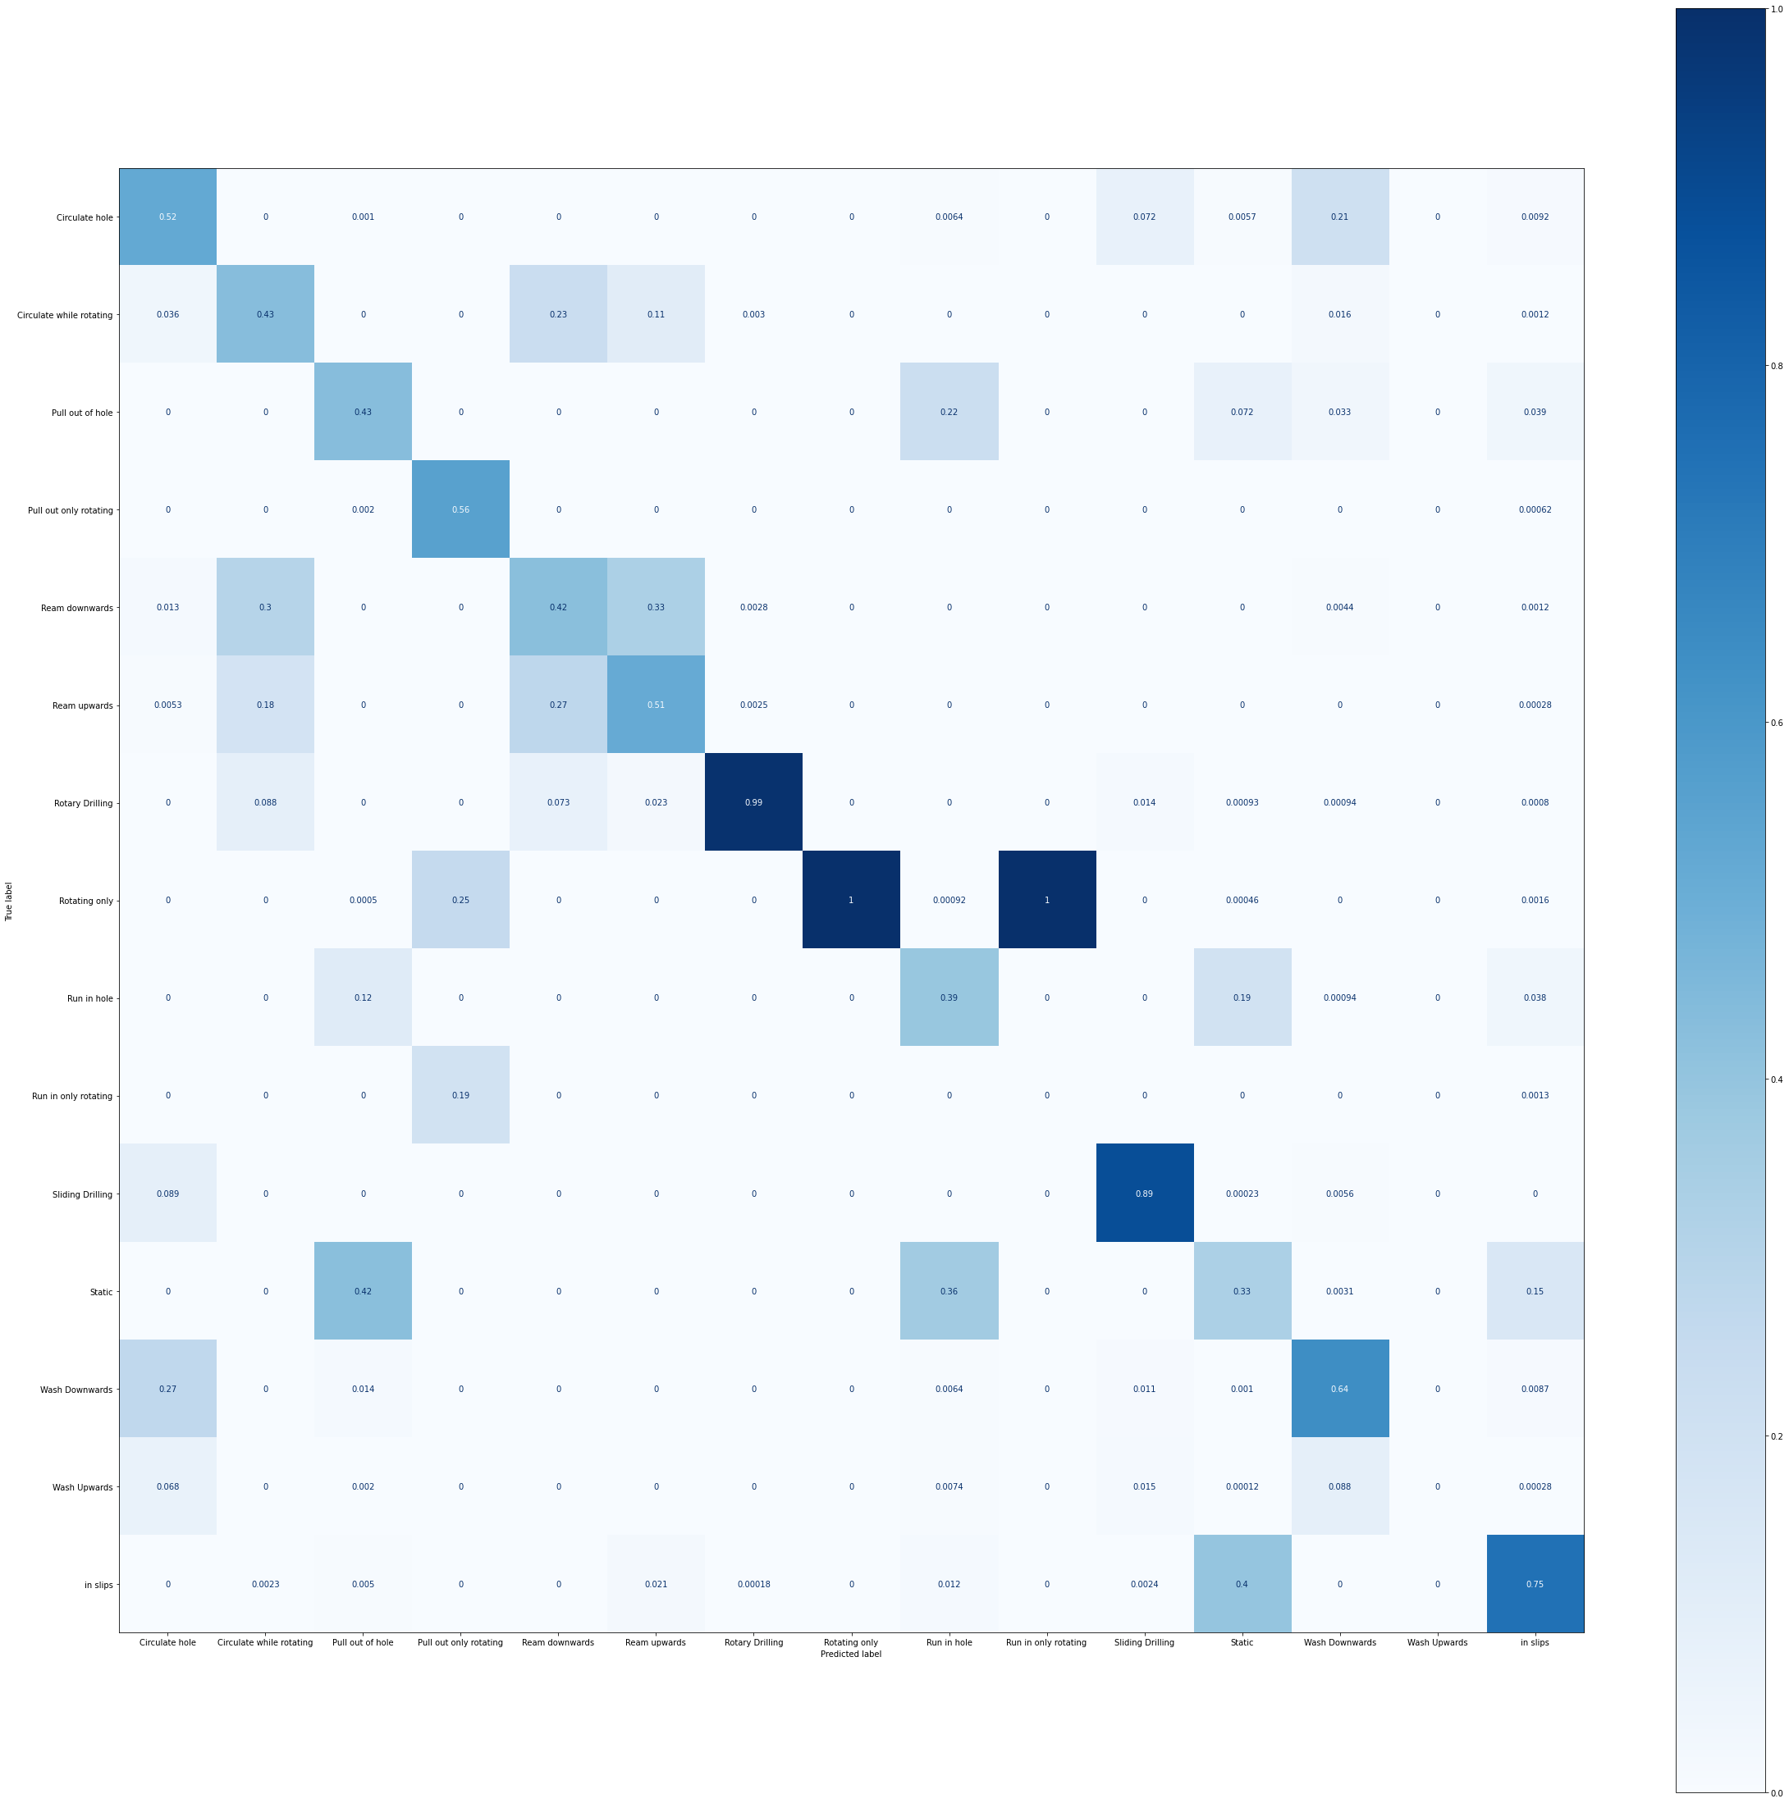
Logistic Regression
Trained using newton-cg solver with no regularization (C=1)

Slide 18
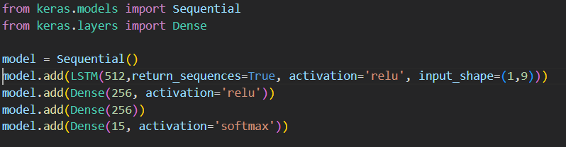
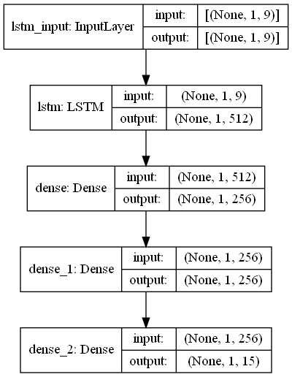
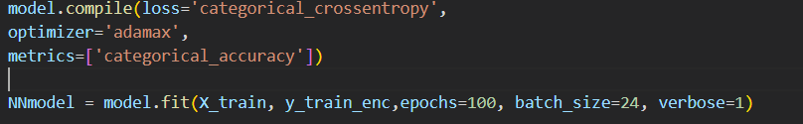
ANN : LSTM
Convert labels (Y_train and Y_test) using LabelEncoder() and to_categorical()
Reshape data as required
Create Keras Sequential model with 3 hidden Dense layers to shape output
Final dense layer with softmax activation for multiclass classification
Fit model to training set

Slide 19
ANN : LSTM
Convert labels (Y_train and Y_test) using LabelEncoder() and to_categorical()
Reshape data as required
Create Keras Sequential model with 3 hidden Dense layers to shape output
Final dense layer with softmax activation for multiclass classification
Fit model to training set

Slide 20
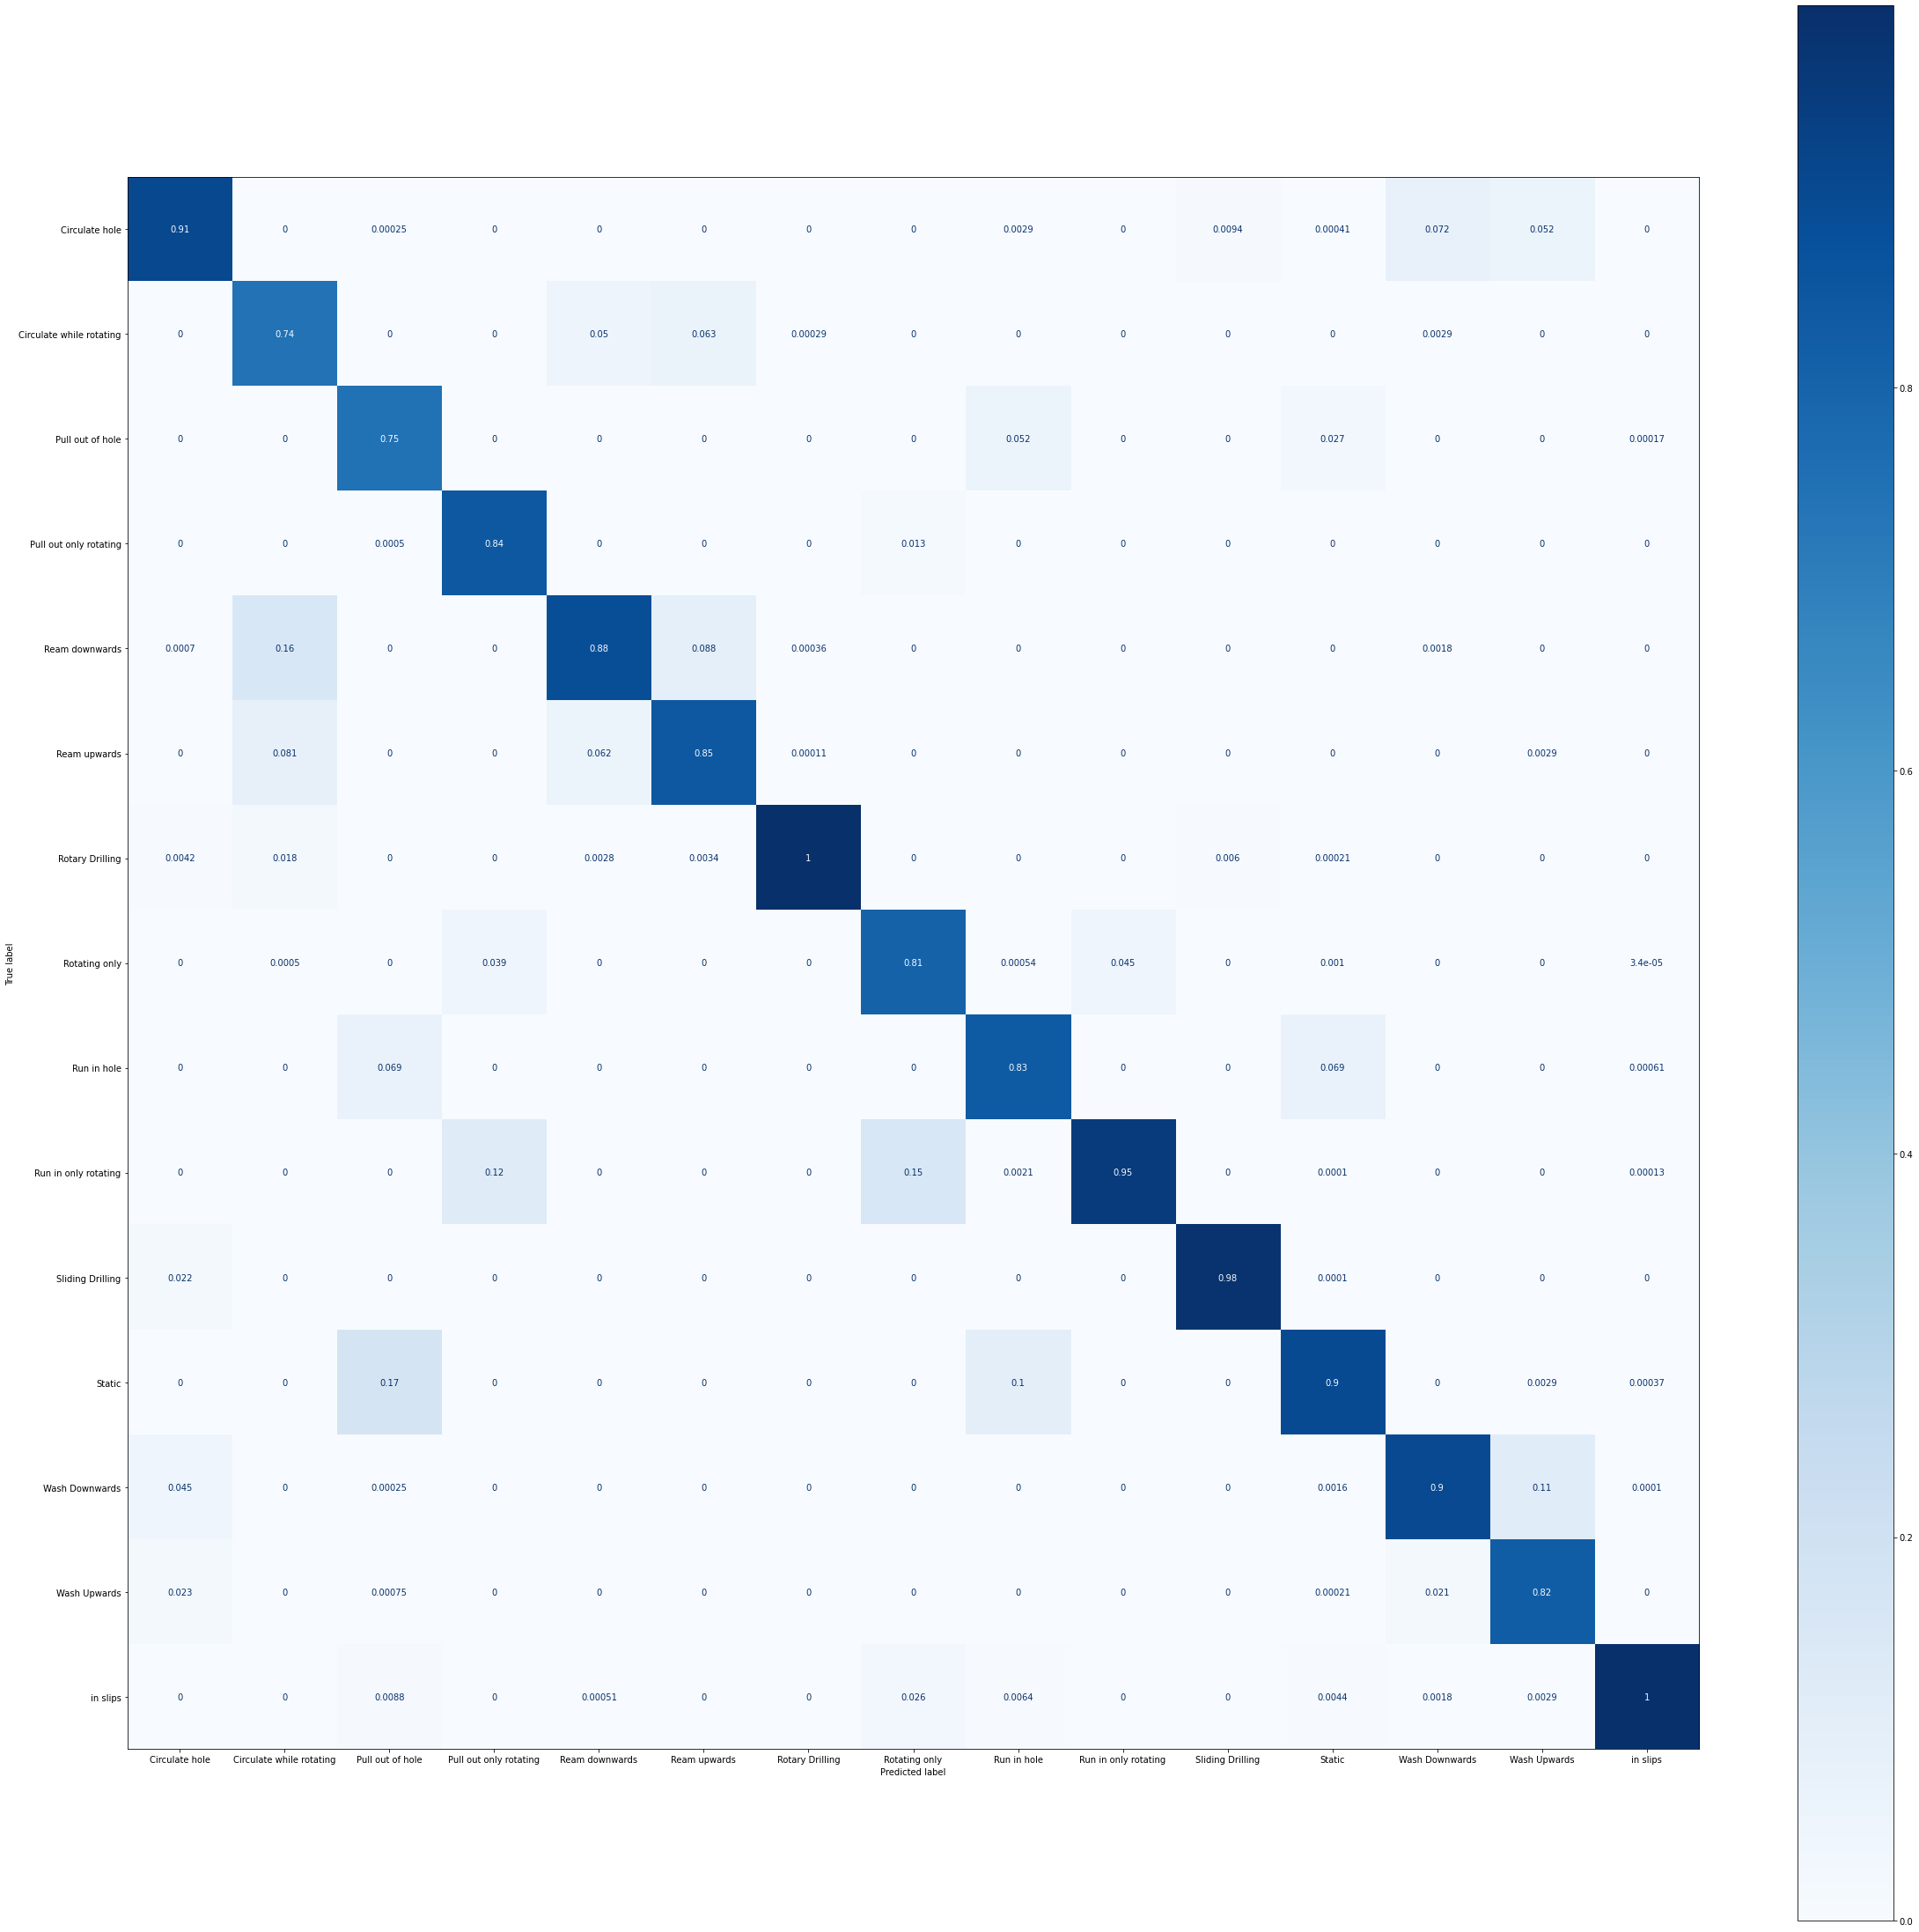
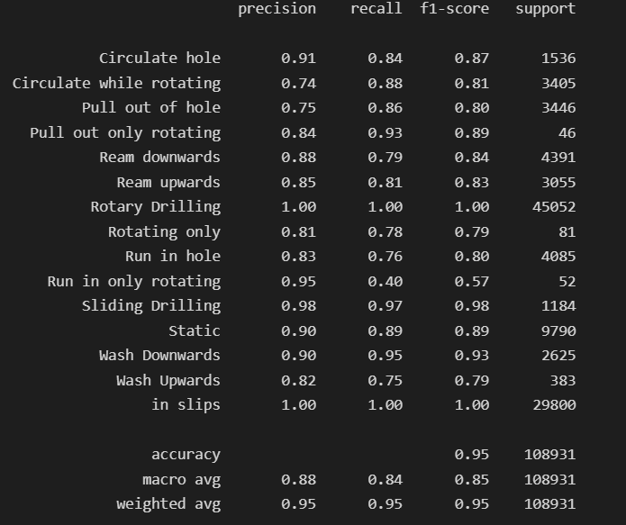
ANN : LSTM

Slide 21
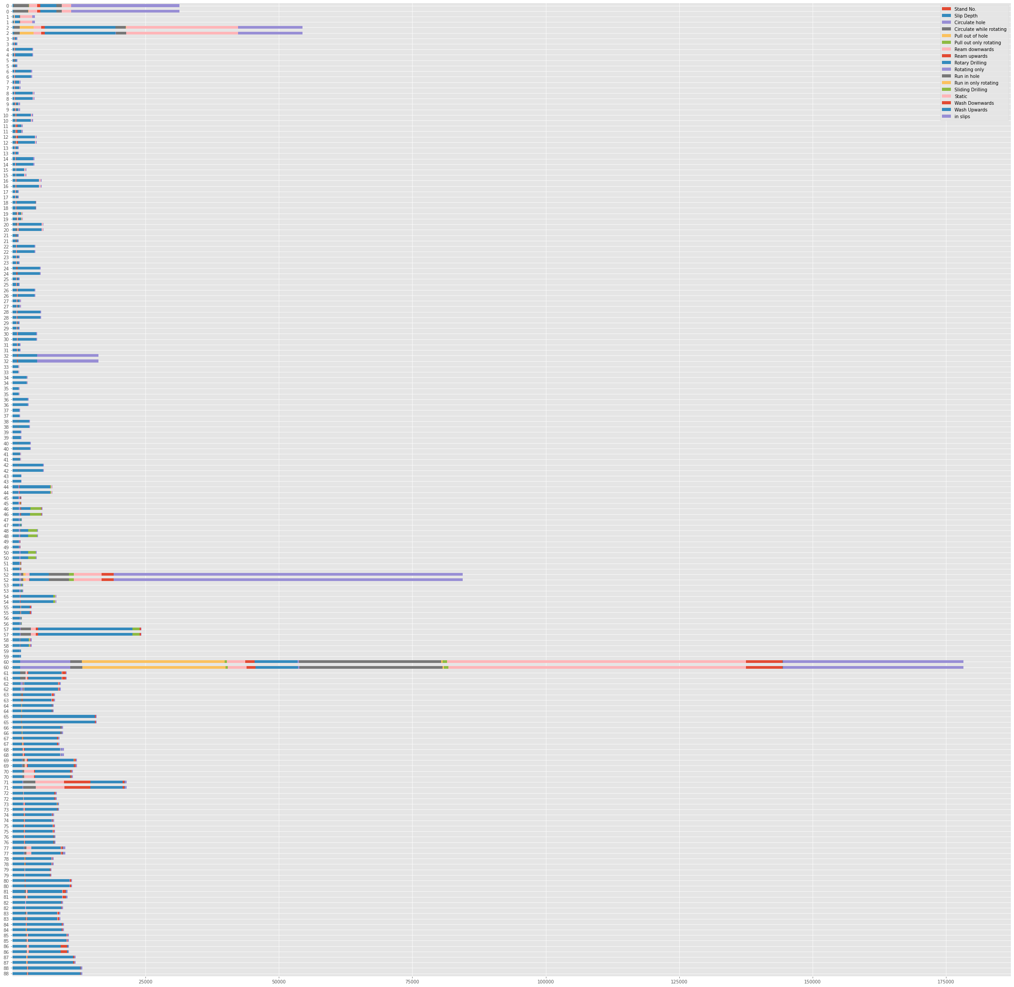
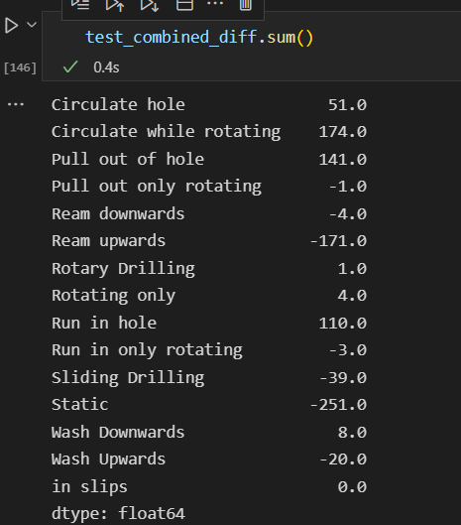
KPI
Final KPI calculation of states comparison between conditional labeller and decision tree model
Data set encompass two sections with over 15 days of data
Max difference is Static label

Slide 22
Model Comparison
Multi class classification problem : all classes assumed similar weightage
Focus on macro average
Highest performing model : Decision Tree, K Nearest Neighbor, LSTM , Logistic Regression
From classification report, observe sample size related to lack of accuracy for certain classes
Labelling method also not fully accurate
Related to block movement , can see classifiers have issues with misidentification with action upwards/downwards. Eg : circulate with rotation vs ream upwards/downwards
Original labeller used a time average movement of block which may not be accurate
Attempt to use CNN-LSTM model (https://machinelearningmastery.com/how-to-develop-rnn-models-for-human-activity-recognition-time-series-classification/ )

